Slide 1
ONLINE MOOC COURSE SYSTEM
ABHIJITH M
Roll No: 02
PRODUCT OWNER: Mr.HYDERALI K

Slide 2
TABLE OF CONTENTS
Introduction
Modules
Methodology
Developing Environment
Future Enhancement
Product Backlog
User Stories
Project Plan
Sprint Plans
Sprint Actual

Slide 3
ONLINE MOOC COURSE SYSTEM
MOOC course is an online platform where students can learn new courses through online. In this system students can register for different courses taught by specialized teachers.
Students can select course based on their branch of studying.
After completion of course Student will receive a certificate, specifying the subject, duration and the signature of tutor.
The Result will be very precise and accurate

Slide 4
MODULES
ADMIN
Login
Add Course
Add Teacher
Payment record update
View complaint
TEACHER
Login
Add notes & tutorial videos
Payment receiving section
Schedule online class
Question & answer section
View rating
Evaluate the answers

Slide 5
MODULES
STUDENT
Registration
Login
View courses
Payment and registration
View scheduled online class
Assign rating to teachers
Question answer Section
Send complaint
View Result

Slide 6
METHODOLOGY

Slide 7
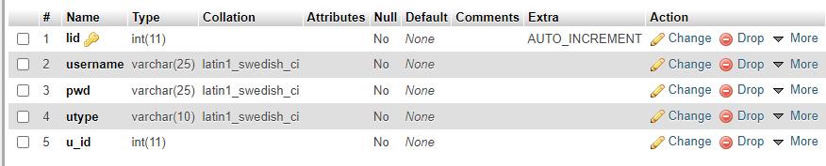
TABLES
Login

Slide 8
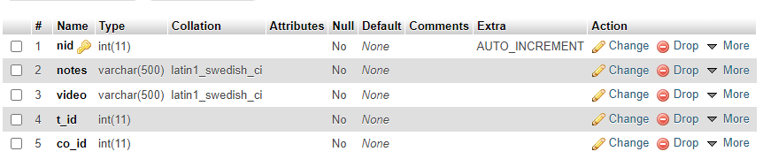
course
NOTES

Slide 9
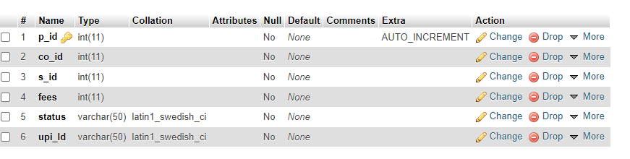
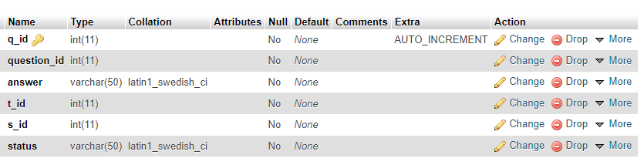
PAYMENT
QUESTIONS

Slide 10
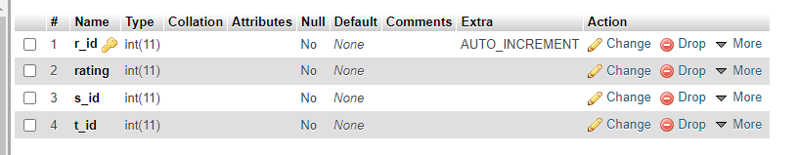
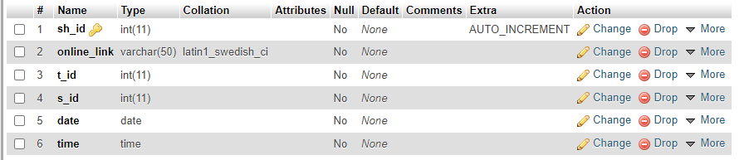
RATING
SCHEDULE

Slide 11
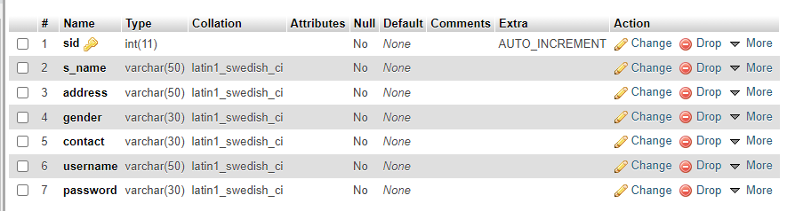
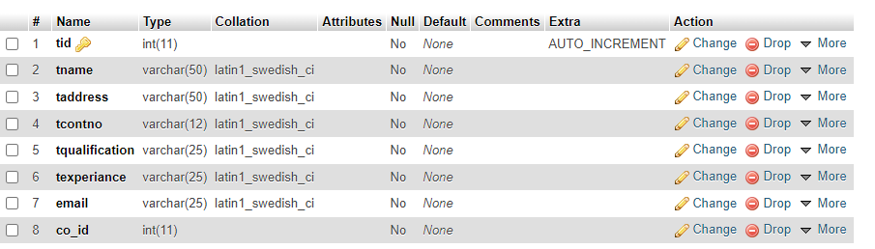
STUDENT
TEACHER

Slide 12
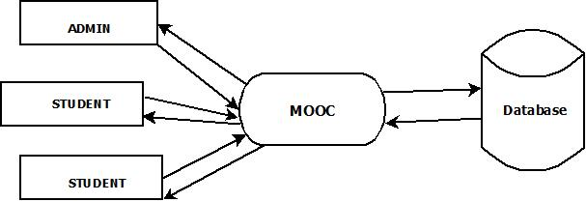
DATA FLOW DIAGRAM
LEVEL 0

Slide 13
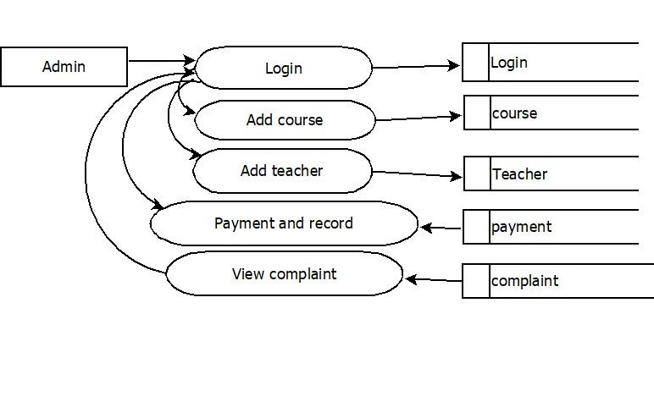
DATA FLOW DIAGRAM
LEVEL 1

Slide 14
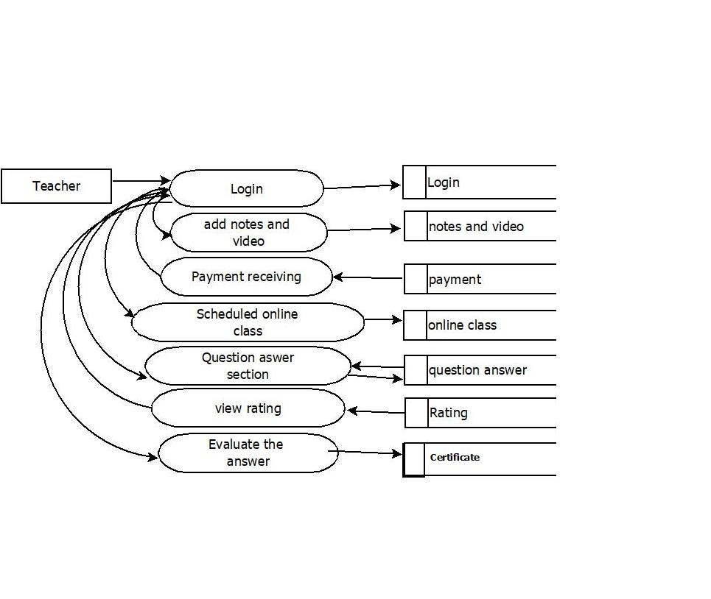
DATA FLOW DIAGRAM
LEVEL 2

Slide 15
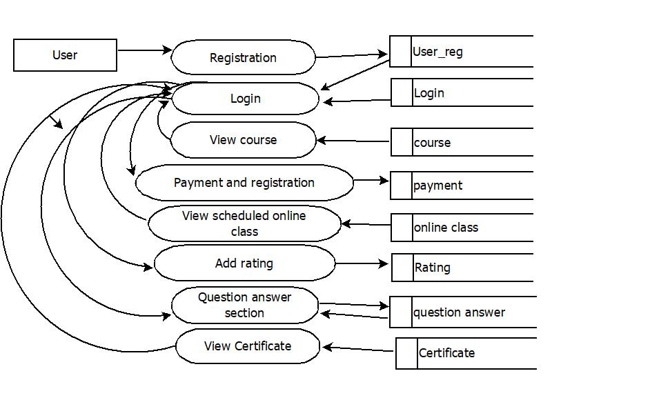
DATA FLOW DIAGRAM
LEVEL 3

Slide 16
FUTURE ENHANCEMENTS
The project has a very vast scope in future.In upcoming days we can enhance the system by conducting webinar and also activities like practice quizzes.

Slide 17
DEVELOPING ENVIRONMENT
Front End : Html,CSS,Java script
Back end : Python-django
Database : MySQL
IDE : PyCharm
OS : Windows/Linux
Processor : i3
RAM : 4GB

Slide 18
PRODUCT BACKLOG
User story ID | Priority <High/Medium/Low> | Size (Hours) | Sprint <#> | Status <Planned/In progress/Completed> | Release Date | Release Goal
1 | Medium | 3 | 1 | Completed | 15-11-2021 | Admin want to login
2 | High | 3 |  | Completed | 17-11-2021 | Admin want to add teacher and manage course
3 | Medium | 3 | 2 | Completed | 22-11-2021 | Teacher want to login
4 | High | 4 |  | Completed | 24-11 2021 | Teacher want add notes and videos
5 | Medium | 4 |  | Completed | 27-11-2021 | User want to register and login
6 | Medium | 3 |  | Completed | 29-11-2022 | User want to view courses
7 | High | 4 |  | Completed | 01-12-2021 | User want to Pay and register the course

Slide 19
PRODUCT BACKLOG
User story ID | Priority <High/Medium/Low> | Size (Hours) | Sprint <#> | Status <Planned/In progress/Completed> | Release Date | Release Goal
8 | Medium | 3 | 3 | Completed | 17-01-2022 | Admin and teacher view payment
9 | High | 3 |  | Completed | 19-01-2022 | User view scheduled online class
10 | Medium | 1 |  | Completed | 21-01-2022 | User want to add ratiing
11 | Medium | 1 |  | Completed | 22-01-2022 | Teacher want to view rating
10 | High | 3 |  | Completed | 27-01-2022 | Teacher want to Add question
12 | High | 4 |  | Completed | 29-01-2022 | User want to answer the question
13 | Medium | 3 |  | Completed | 31-01-2022 | Teacher want to evaluate the answer
14 | Medium | 3 | 4 | Completed | 02-02-2022 | User want to post complaint
15 | Medium | 2 |  | Completed | 07-02-2022 | Admin want to view complaint and post reply
16 | Medium | 1 |  | Completed | 14-02-2022 | User want to view Certificate

Slide 20
USER STORY
User story ID | Priority <High/Medium/Low> | Size (Hours) | Sprint <#> | Status <Planned/In progress/Completed> | Release Date | Release Goal
1 | Medium | 3 | 1 | Completed | 27-12-2021 | Admin want to login
2 | High | 3 |  | Completed | 28-12-2021 | Admin want to add teacher and manage course
3 | Medium | 3 | 2 | Completed | 13-01-2022 | Teacher want to login
4 | High | 4 |  | Completed | 14-01-2022 | Teacher want add notes and videos
5 | Medium | 4 |  | Completed | 16-01-2022 | User want to register and login
6 | Medium | 3 |  | Completed | 17-01-2022 | User want to view courses
7 | High | 4 |  | Completed | 18-01-2022 | User want to Pay and register the course

Slide 21
USER STORY
User Story ID | As a type of User | I want to <perform some task> | So that I can < Achieve Some Goal>
11 | User | Add rating | Students can add rating to their teacher
12 | Teacher | View rating | Teacher can view the rating
11 | Teacher | Add questions | Students can access the questions
12 | user | Answer the question | Participate the exam
13 | Teacher | Evaluate the answer | Publish the mark
14 | User | Post complaint | Post complaint and view response
15 | Admin | View complaint | View complaint and send response
16 | User | View Certificate | User can view Certificate

Slide 22
PROJECT PLAN
User Story ID | Task Name | Start Date | End Date | Days | Status
1 | Sprint 1 | 15/11/2021 | 15/12/2021 | 2 | Completed
2 |  | 17/11/2021 | 17/11/2021 |  | Completed
3 | Sprint 2 | 22/11/2021 | 22/12/2021 | 5 | Completed
4 |  | 24/11/2021 | 24/12/2021 |  | Completed
5 |  | 27/11/2021 | 27/12/2021 |  | Completed
6 |  | 29/11/2021 | 29/11/2021 |  | Completed
7 |  | 01/12/2021 | 01/12/2021 |  | Completed
8 | Sprint 3 | 17/01/2022 | 17/01/2022 | 6 | Completed
9 |  | 19/01/2022 | 19/01/2022 |  | Completed
10 |  | 21/01/2022 | 21/01/2022 |  | Completed
11 |  | 25/01/2022 | 25/01/2022 |  | Completed
12 |  | 29/01/2022 | 29/01/2022 |  | Completed
13 |  | 31/01/2022 | 31/01/2022 |  | Completed
14 | Sprint 4 | 02/02/2022 | 02/02/2022 | 2 | Completed
15 |  | 07/2/2022 | 07/2/2022 |  | Completed
16 |  | 14/2/2022 | 14/2/2022 |  | Completed

Slide 23
SPRINT BACKLOG PLAN
Backlog Item | Status and Completion date | Original Estimate in hours | Day 1 | Day 2 | Day 3 | Day 4 | Day 5 | Day 6 | Day 7 | Day 8 | Day 9 | Day 10 | Day 11 | Day 12 | Day 13
User story #1,2 |  |  | Hours | Hours | Hours | Hours | Hours | Hours | Hours | Hours | Hours | Hours | Hours | Hours | Hours
UI Designing | 15/11/21 | 2 | 2 | 0 | 0 | 0 | 0 | 0 | 0 | 0 | 0 | 0 | 0 | 0 | 0
Database Connectivity | 17/11/21 | 2 | 0 | 2 | 0 | 0 | 0 | 0 | 0 | 0 | 0 | 0 | 0 | 0 | 0
Coding | 17/11/21 | 2 | 0 | 2 | 0 | 0 | 0 | 0 | 0 | 0 | 0 | 0 | 0 | 0 | 0
Testing | 17/11/21 | 2 | 0 | 2 | 0 | 0 | 0 | 0 | 0 | 0 | 0 | 0 | 0 | 0 | 0
User story #3,4,5,6,7
UI Designing | 22/11/21 | 5 | 0 | 0 | 5 | 0 | 0 | 0 | 0 | 0 | 0 | 0 | 0 | 0 | 0
Database Connectivity | 24/11/21 | 3 | 0 | 0 | 0 | 3 | 0 | 0 | 0 | 0 | 0 | 0 | 0 | 0 | 0
Coding | 01/12/21 | 6 | 0 | 0 | 0 | 0 | 6 | 0 | 0 | 0 | 0 | 0 | 0 | 0 | 0
Testing | 01/12/21 | 4 | 0 | 0 | 0 | 0 | 4 | 0 | 0 | 0 | 0 | 0 | 0 | 0 | 0
User story #,8,9,10,11,12,13
UI Designing | 13/12/21 | 4 | 0 | 0 | 0 | 0 | 0 | 4 | 0 | 0 | 0 | 0 | 0 | 0 | 0
Database Connectivity | 17/01/22 | 3 | 0 | 0 | 0 | 0 | 0 | 3 | 0 | 0 | 0 | 0 | 0 | 0 | 0
Coding | 24/01/22 | 3 | 0 | 0 | 0 | 0 | 0 | 0 | 3 | 0 | 0 | 0 | 0 | 0 | 0
Testing | 24/01/22 | 2 | 0 | 0 | 0 | 0 | 0 | 0 | 0 | 2 | 0 | 0 | 0 | 0 | 0
User story #14,15,16
UI Designing | 02/02/22 | 4 | 0 | 0 | 0 | 0 | 0 | 0 | 0 | 0 | 4 | 0 | 0 | 0 | 0
Database Connectivity | 02/02/22 | 2 | 0 | 0 | 0 | 0 | 0 | 0 | 0 | 0 | 0 | 2 | 0 | 0 | 0
Coding | 07/02/22 | 3 | 0 | 0 | 0 | 0 | 0 | 0 | 0 | 0 | 0 | 0 | 3 | 0 | 0
Testing | 14/02/22 | 3 | 0 | 0 | 0 | 0 | 0 | 0 | 0 | 0 | 0 | 0 | 3 | 0 | 0
Total |  | 50 | 2 | 6 | 5 | 3 | 10 | 7 | 3 | 2 | 4 | 2 | 6 | 0 | 0

Slide 24
SPRINT BACKLOG ACTUAL
Backlog Item | Status and Completion date | Original Estimate in hours | Day 1 | Day 2 | Day 3 | Day 4 | Day 5 | Day 6 | Day 7 | Day 8 | Day 9 | Day 10 | Day 11 | Day 12 | Day 13 | Completed <Y/N>
User story #1,2 |  |  | Hours | Hours | Hours | Hours | Hours | Hours | Hours | Hours | Hours | Hours | Hours | Hours | Hours
UI Designing | 15/11/21 | 2 | 2 | 0 | 0 | 0 | 0 | 0 | 0 | 0 | 0 | 0 | 0 | 0 | 0 | Y
Database Connectivity | 17/11/21 | 2 | 0 | 2 | 0 | 0 | 0 | 0 | 0 | 0 | 0 | 0 | 0 | 0 | 0 | Y
Coding | 17/11/21 | 2 | 0 | 2 | 0 | 0 | 0 | 0 | 0 | 0 | 0 | 0 | 0 | 0 | 0 | Y
Testing | 17/11/21 | 2 | 0 | 2 | 0 | 0 | 0 | 0 | 0 | 0 | 0 | 0 | 0 | 0 | 0 | Y
User story #3,4,5,6,7
UI Designing | 22/11/21 | 5 | 0 | 0 | 5 | 0 | 0 | 0 | 0 | 0 | 0 | 0 | 0 | 0 | 0 | Y
Database Connectivity | 14/11/21 | 3 | 0 | 0 | 0 | 3 | 0 | 0 | 0 | 0 | 0 | 0 | 0 | 0 | 0 | Y
Coding | 01/12/21 | 6 | 0 | 0 | 0 | 0 | 6 | 0 | 0 | 0 | 0 | 0 | 0 | 0 | 0 | Y
Testing | 01/12/21 | 4 | 0 | 0 | 0 | 0 | 4 | 0 | 0 | 0 | 0 | 0 | 0 | 0 | 0 | Y
User story #8,9,10,11,12,13
UI Designing | 13/12/21 | 4 | 0 | 0 | 0 | 0 | 0 | 4 | 0 | 0 | 0 | 0 | 0 | 0 | 0 | Y
Database Connectivity | 17/01/22 | 3 | 0 | 0 | 0 | 0 | 0 | 3 | 0 | 0 | 0 | 0 | 0 | 0 | 0 | Y
Coding | 24/01/22 | 3 | 0 | 0 | 0 | 0 | 0 | 0 | 3 | 0 | 0 | 0 | 0 | 0 | 0 | Y
Testing | 24/01/22 | 2 | 0 | 0 | 0 | 0 | 0 | 0 | 0 | 2 | 0 | 0 | 0 | 0 | 0 | Y
User story #14,15,16
UI Designing | 02/02/22 | 4 | 0 | 0 | 0 | 0 | 0 | 0 | 0 | 0 | 4 | 0 | 0 | 0 | 0 | Y
Database Connectivity | 02/02/22 | 2 | 0 | 0 | 0 | 0 | 0 | 0 | 0 | 0 | 0 | 2 | 0 | 0 | 0 | Y
Coding | 07/02/22 | 3 | 0 | 0 | 0 | 0 | 0 | 0 | 0 | 0 | 0 | 0 | 3 | 0 | 0 | Y
Testing | 14/02/22 | 3 | 0 | 0 | 0 | 0 | 0 | 0 | 0 | 0 | 0 | 0 | 3 | 0 | 0 | Y
Total |  | 50 | 2 | 6 | 5 | 3 | 10 | 7 | 3 | 2 | 4 | 2 | 6 | 0 | 0 | Y

Slide 25
THANK YOU

